Slide 1
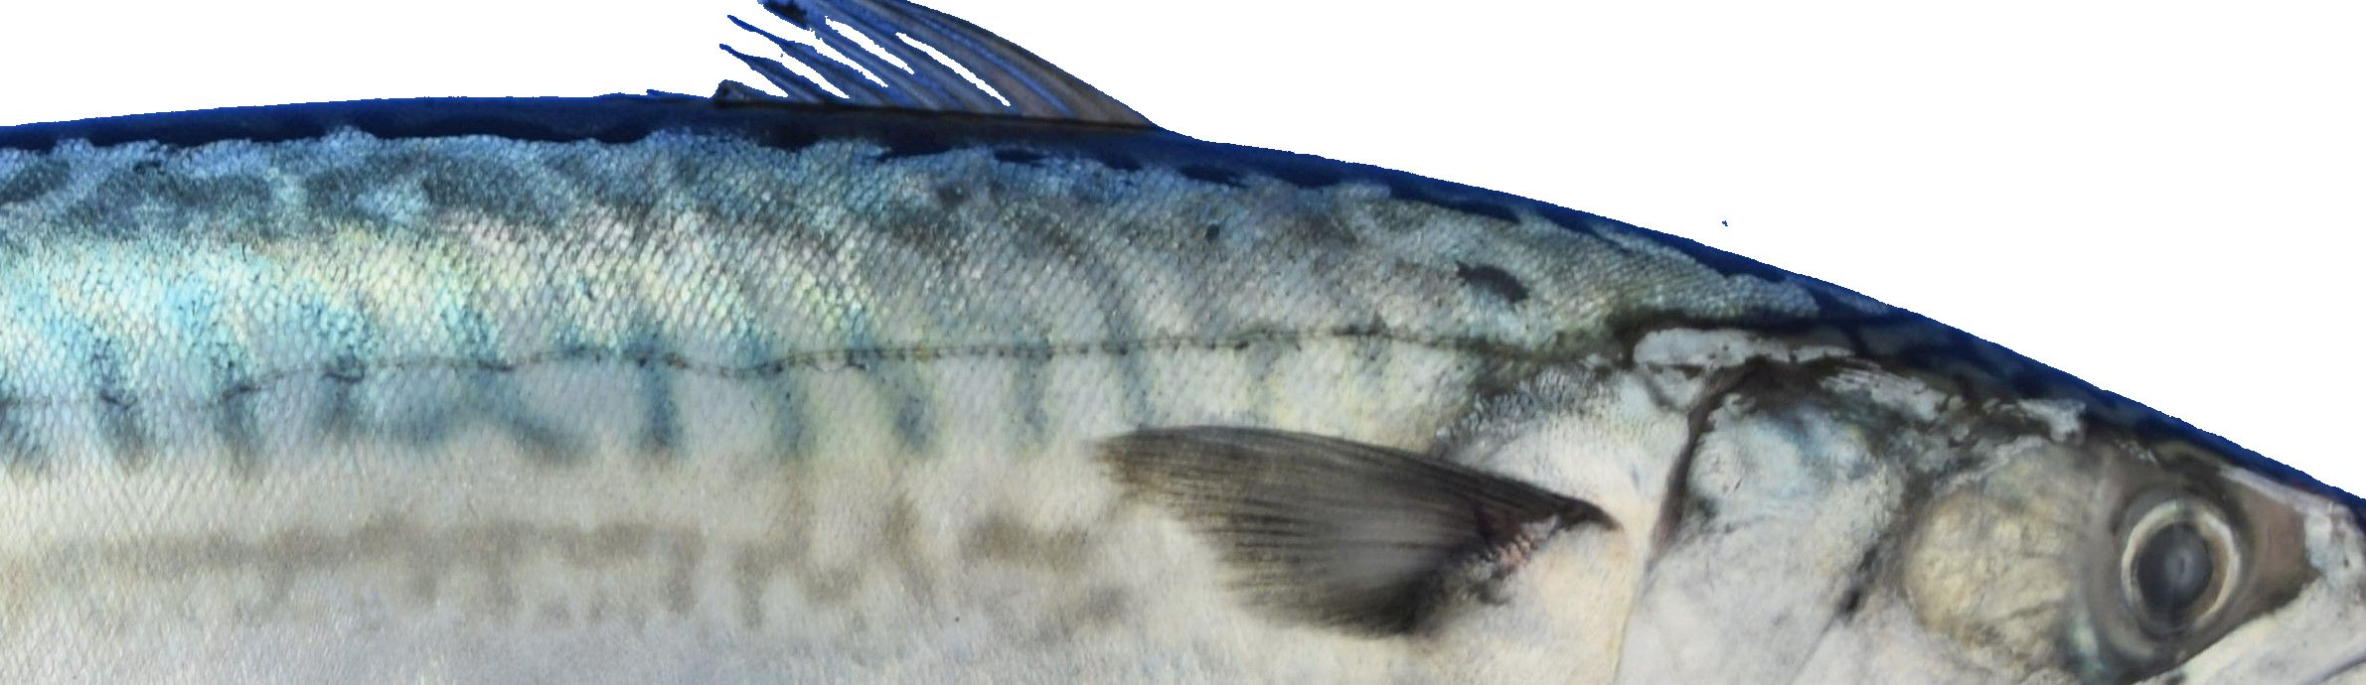
Pelagic species in the Northeast Atlantic
Martin Pastoors
Global Pelagic Forum, 24 April 2023, Barcelona

Slide 2
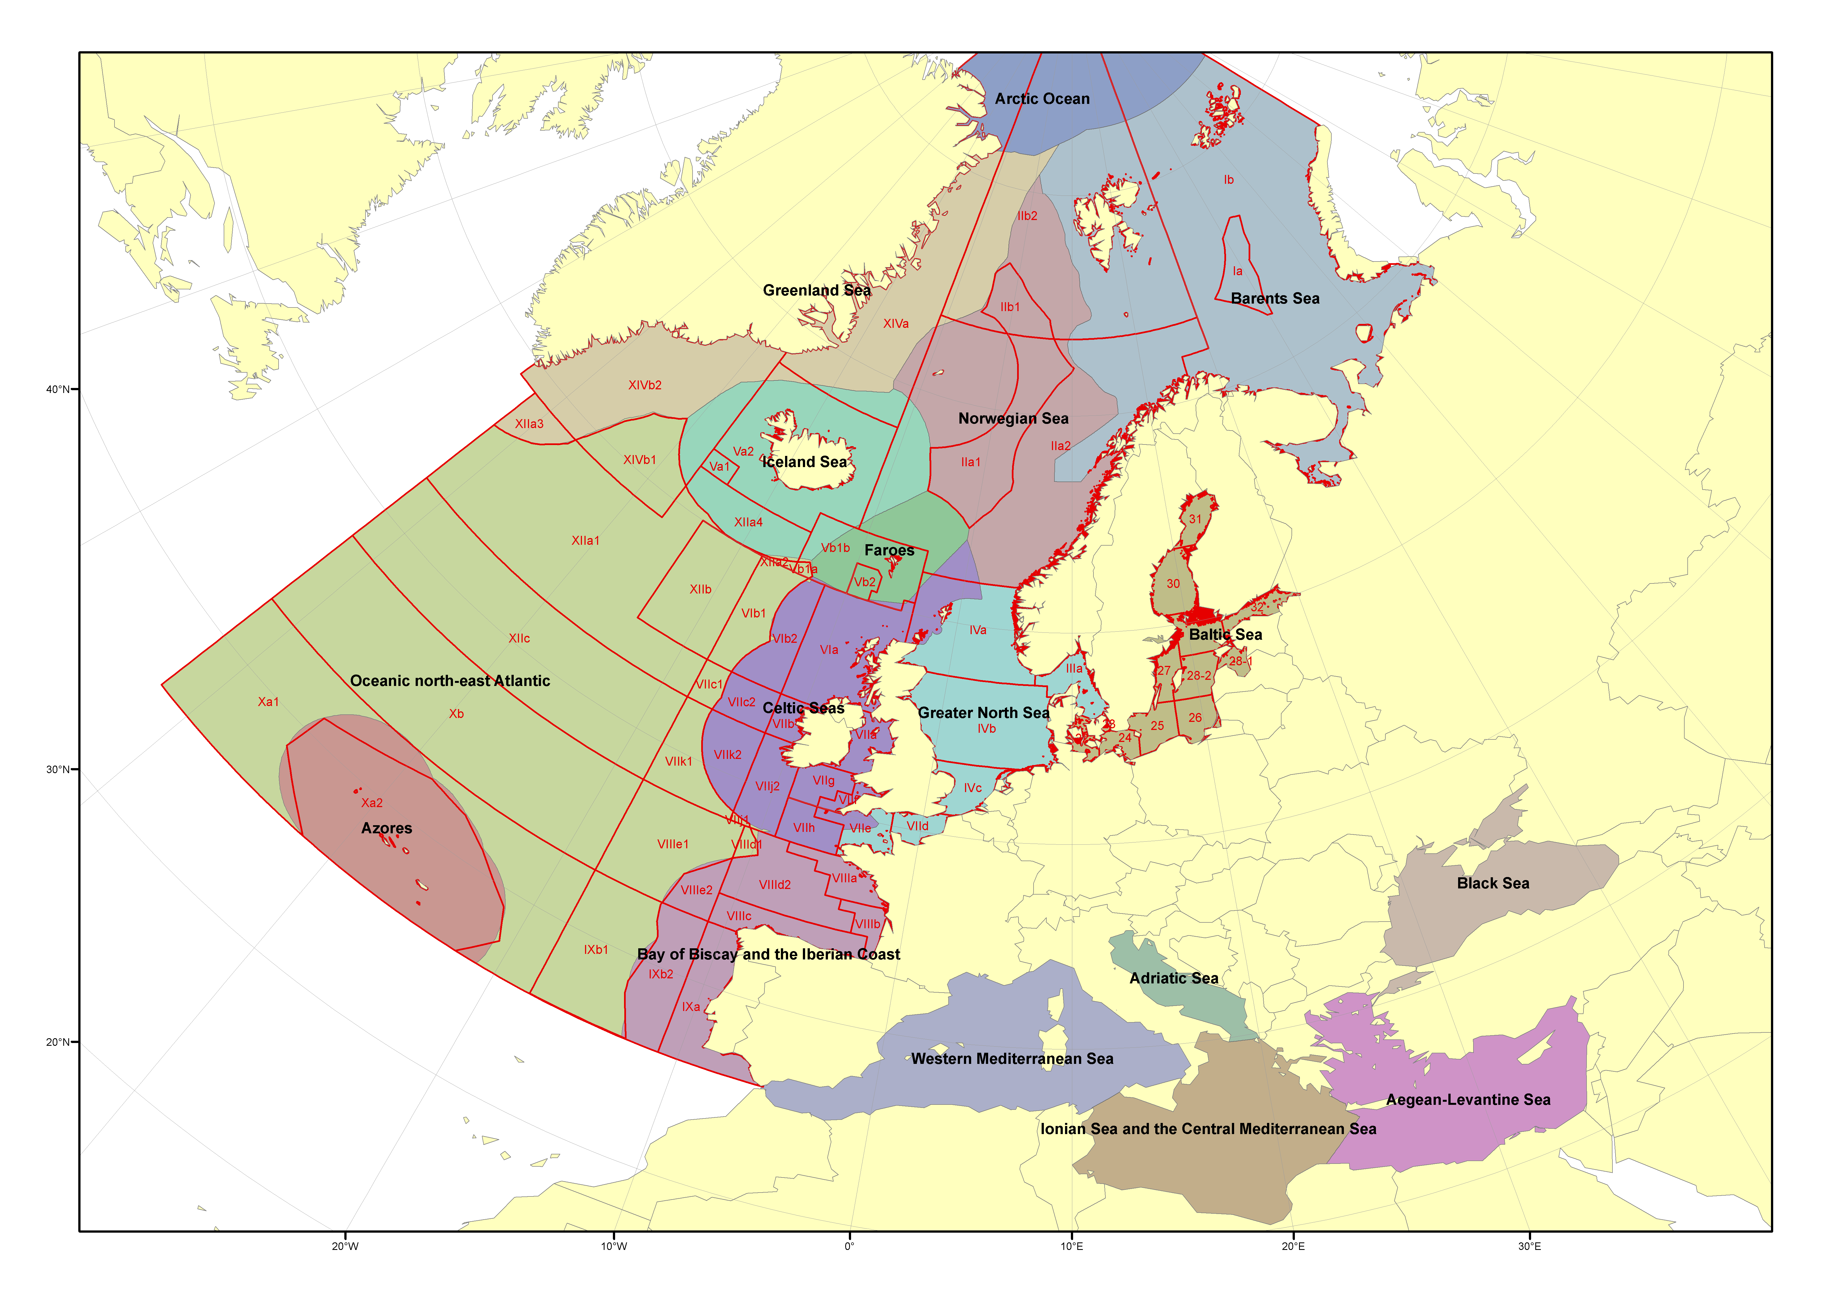
Context of scientific advice in the NE Atlantic
Scientific advice by International Council for the Exploration of the Sea (ICES)

Slide 3
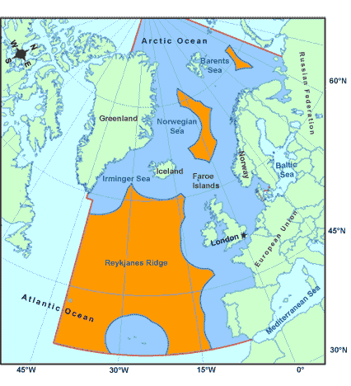
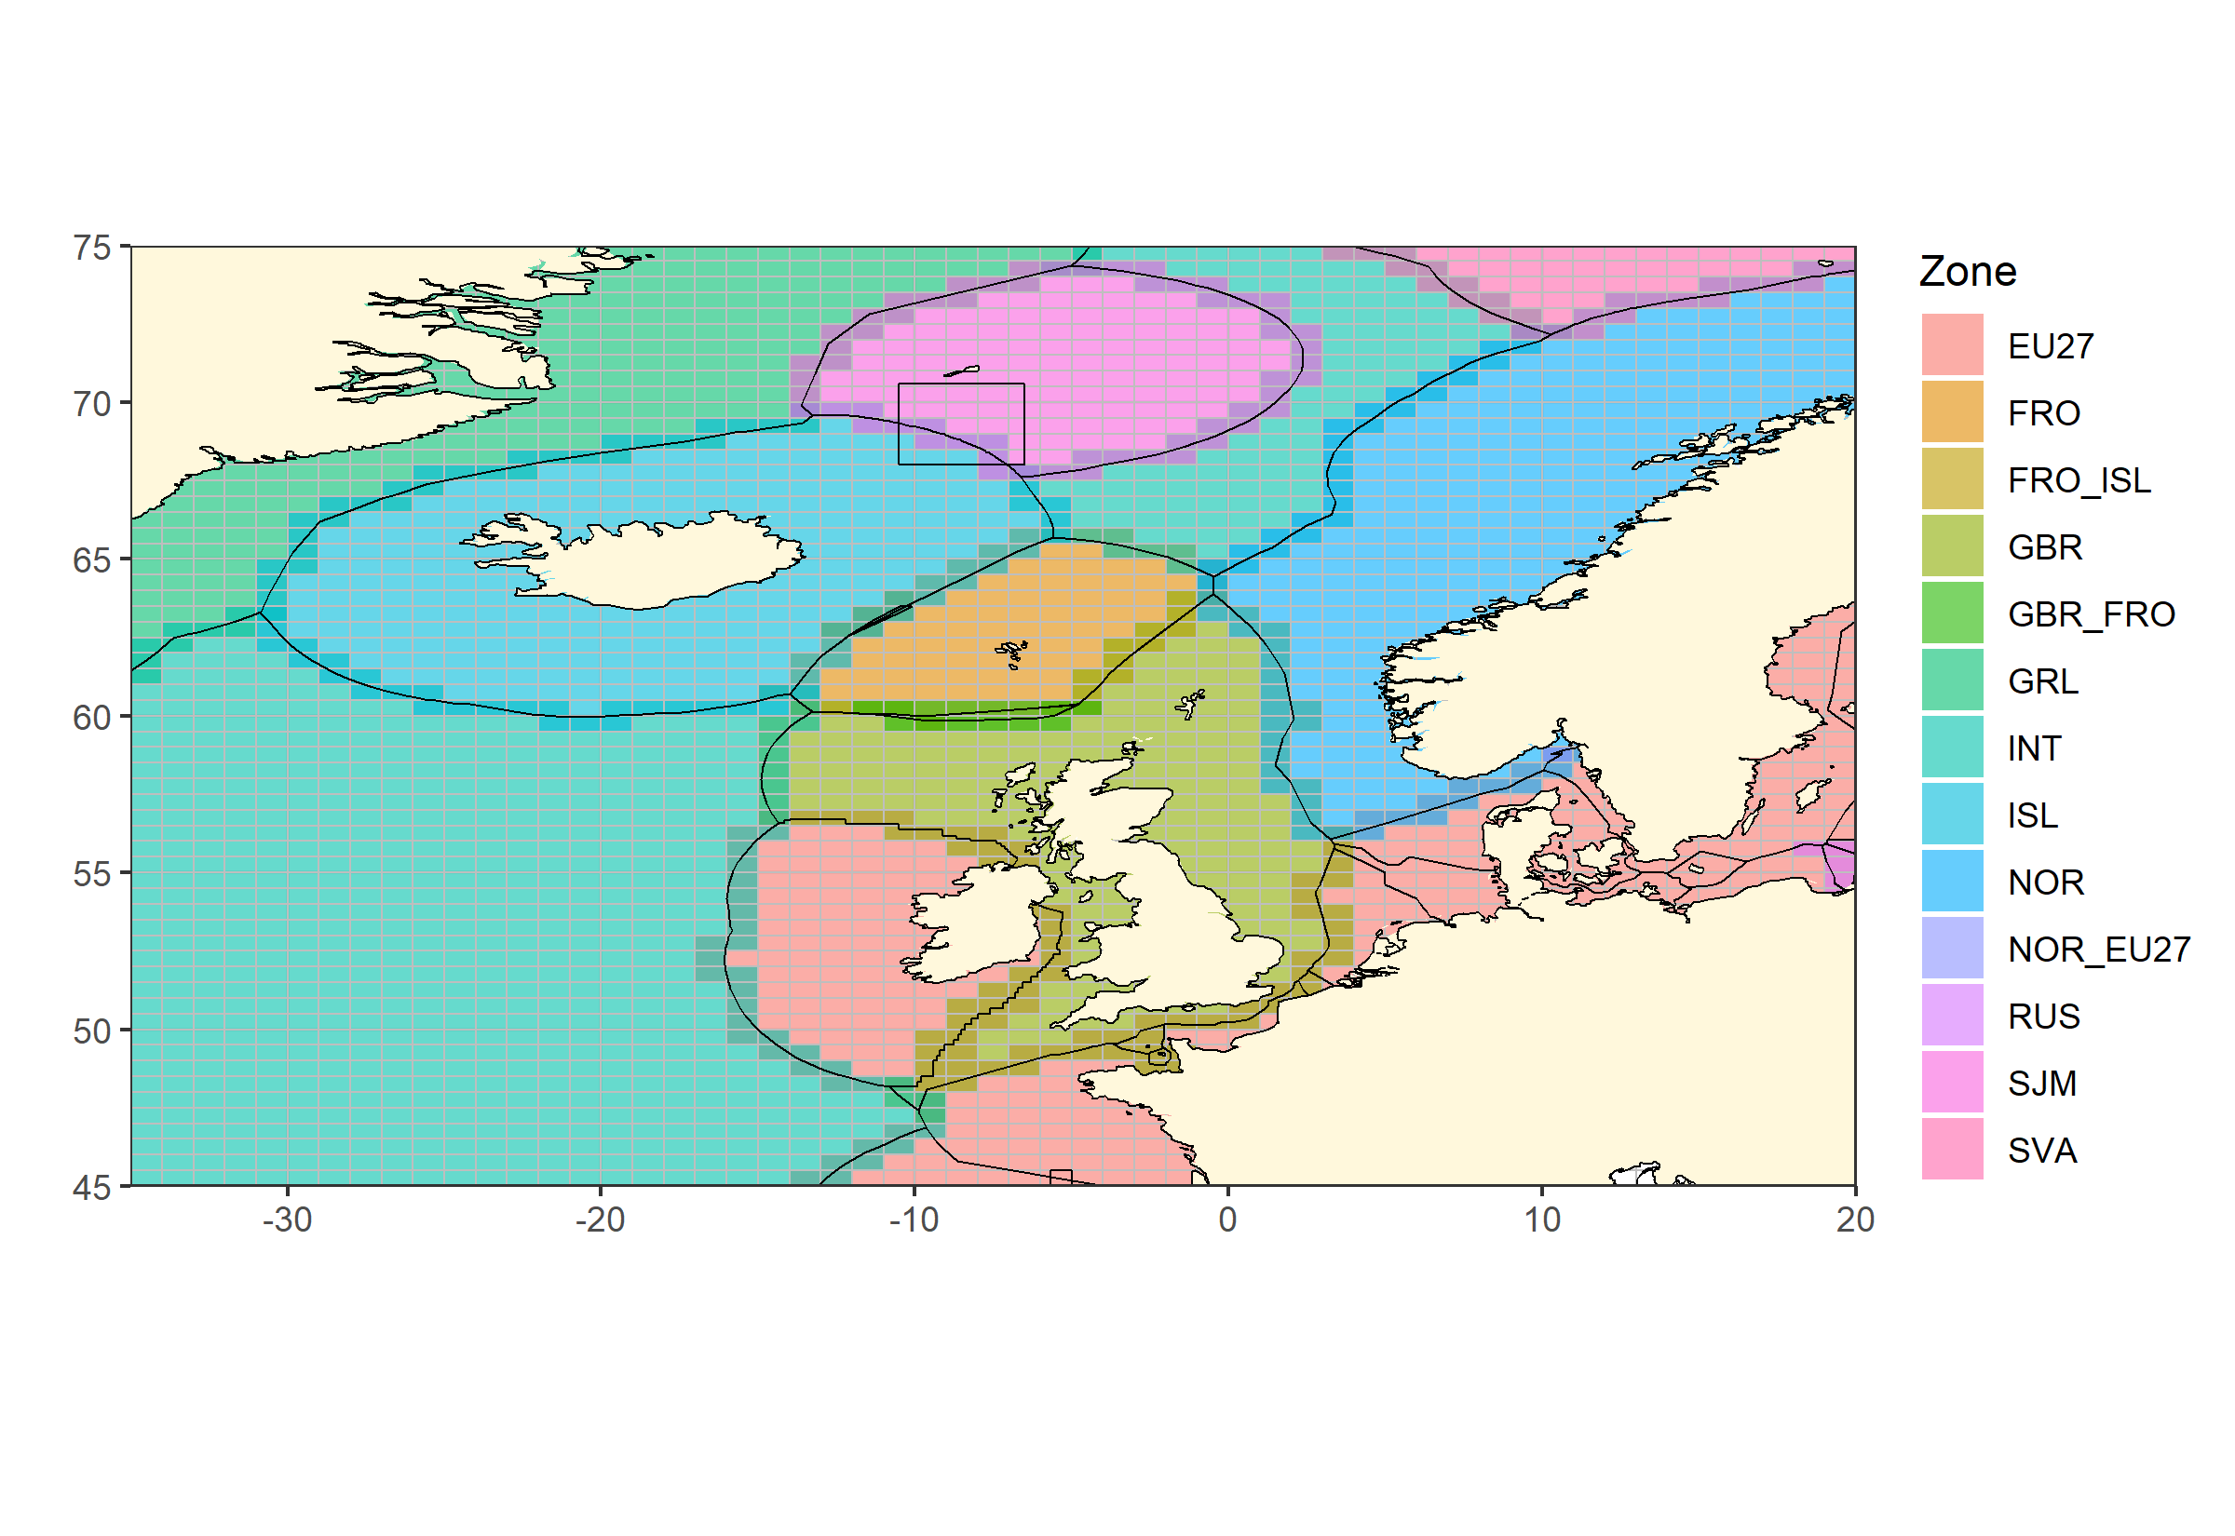
Fisheries management in the NE Atlantic
Northeast Atlantic Fisheries Commission (NEAFC)
Coastal States negotiations

Slide 4
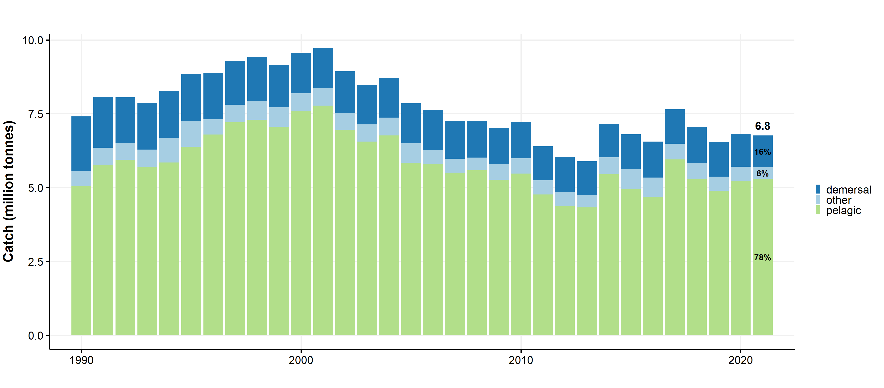
Catches of pelagic, demersal and other stocks

Slide 5
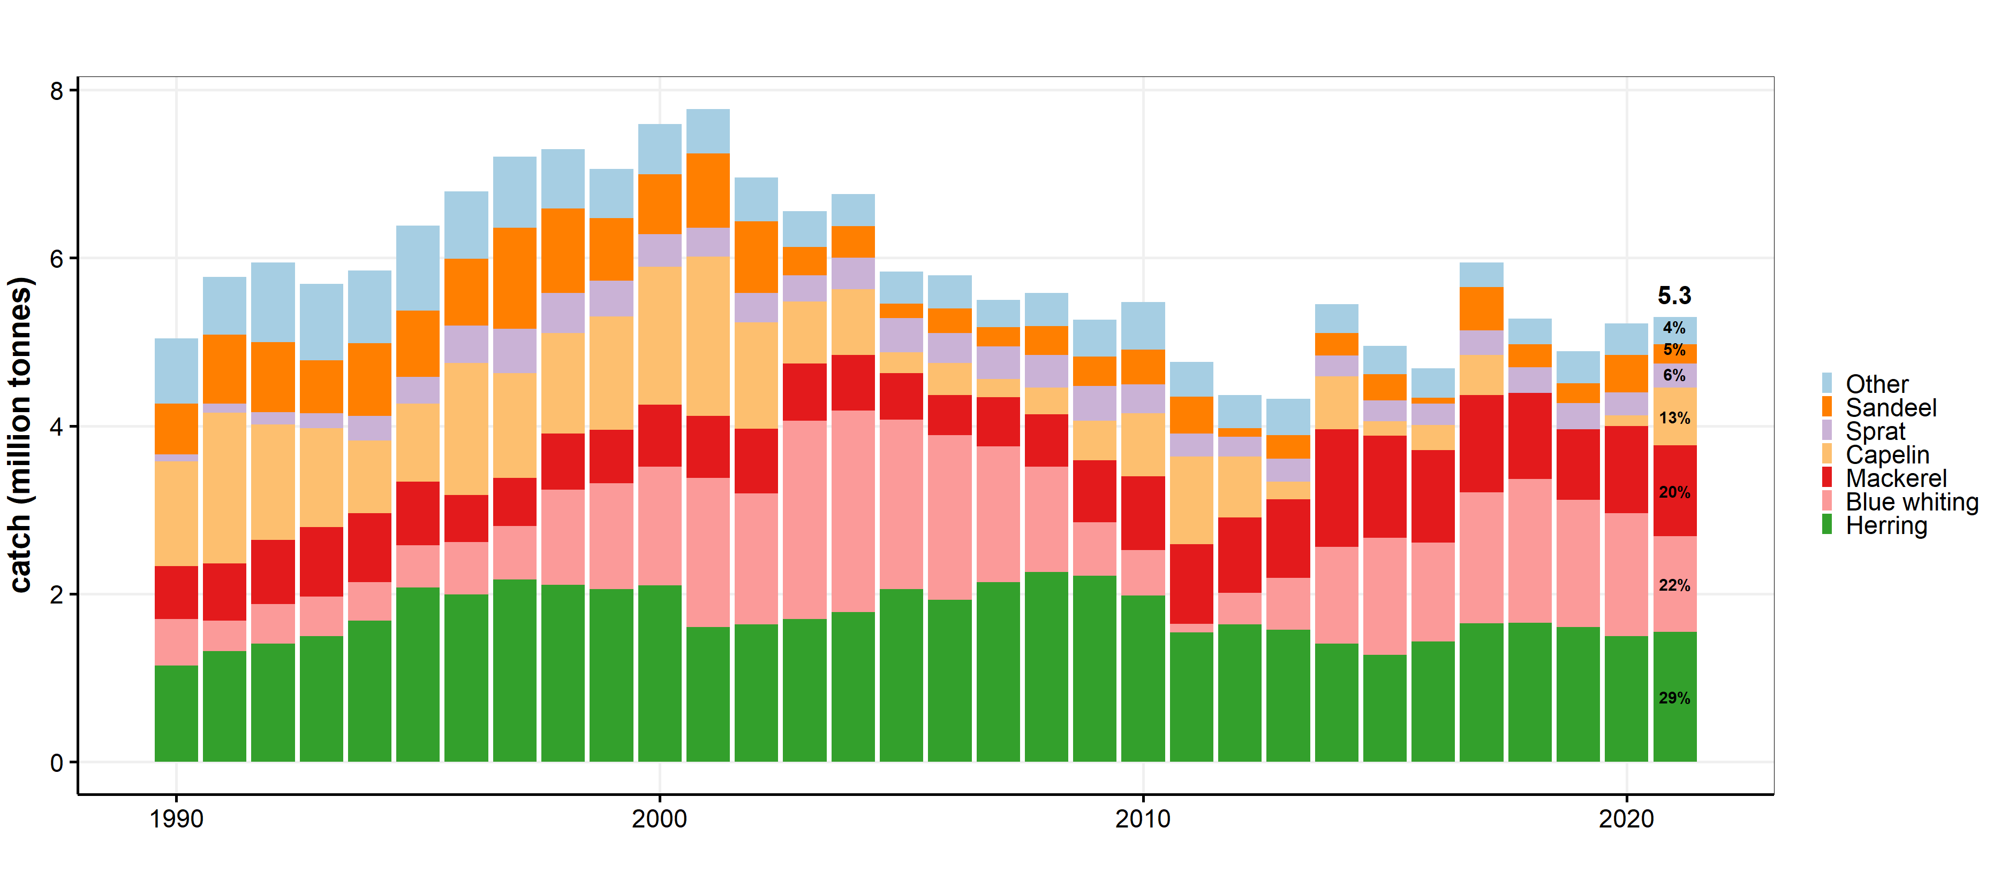
Catches of pelagic species

Slide 6
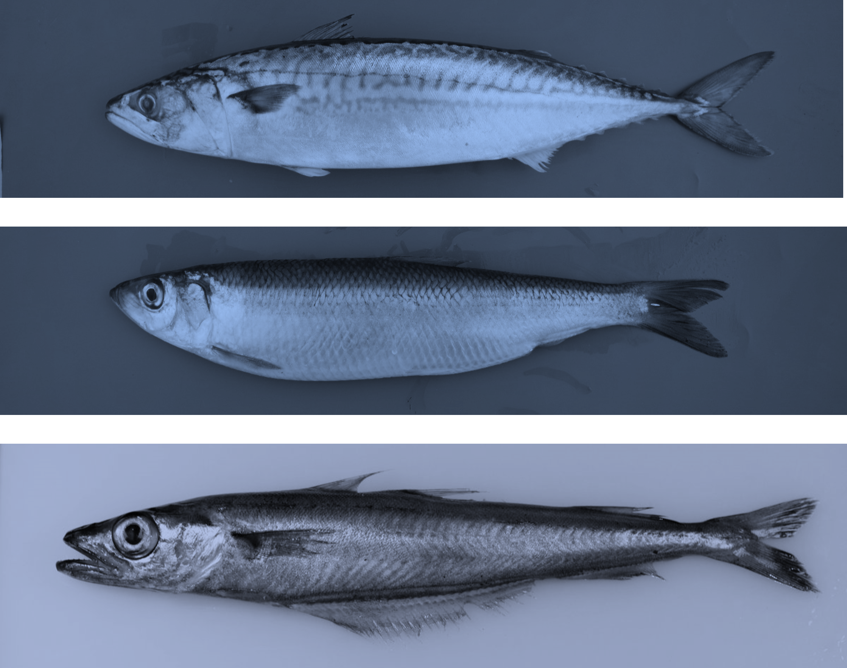
Species
Atlantic mackerel (MAC)
Scomber scombrus
Atlantic herring (HER)
Clupea harengus
Blue whiting (WHB)
Micromesistius poutassou

Slide 7
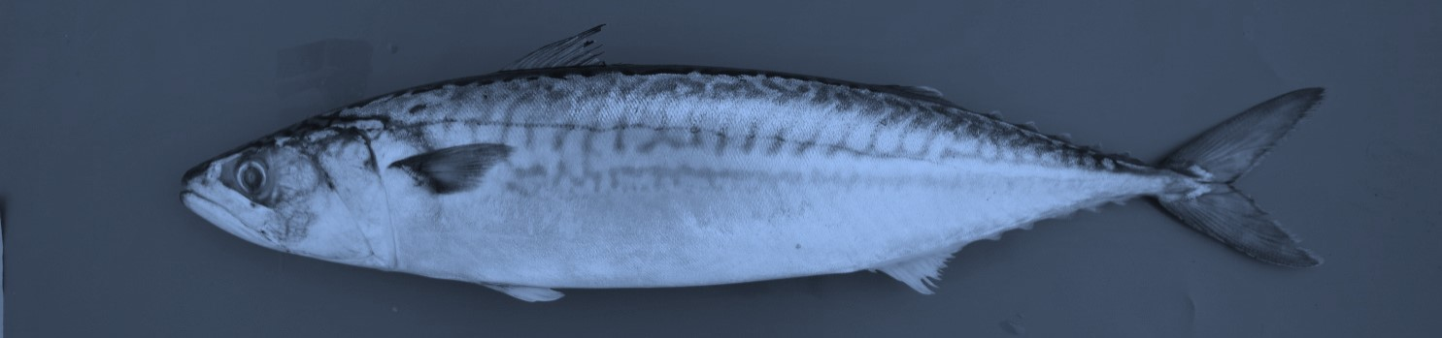
Atlantic mackerel (MAC)

Slide 8
Key aspects of Northeast Atlantic mackerel
Catch area has expanded, and is contracting
No agreement on sharing. Large overshoot catch over advice
High recruitment, but stock coming down
Very uncertain assessment
Advice for 2023 slightly lower than advice 2022

Slide 9
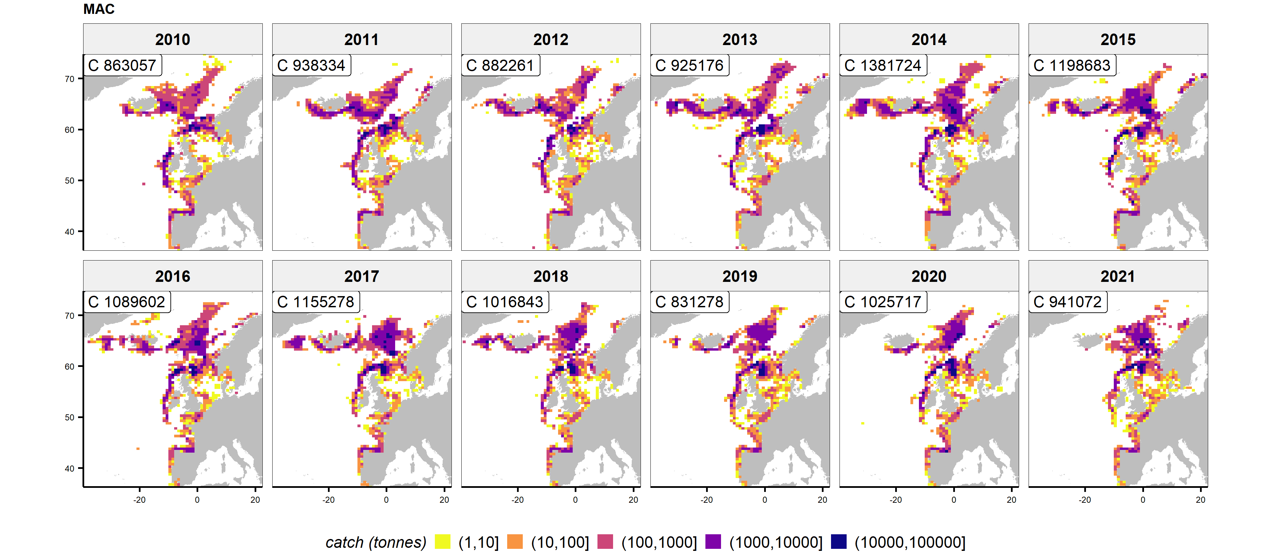
Mackerel: catch area expanding and contracting

Slide 10
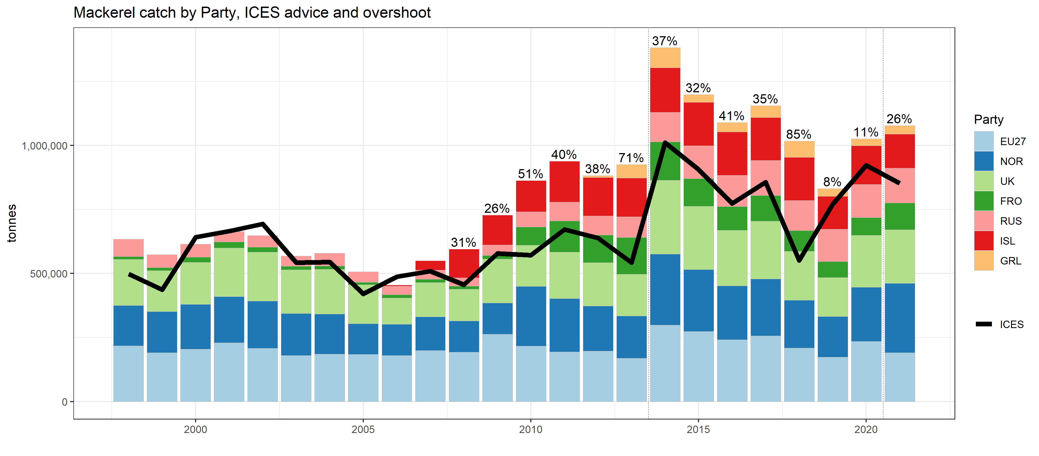
Mackerel: overshoot of catches over advice

Slide 11
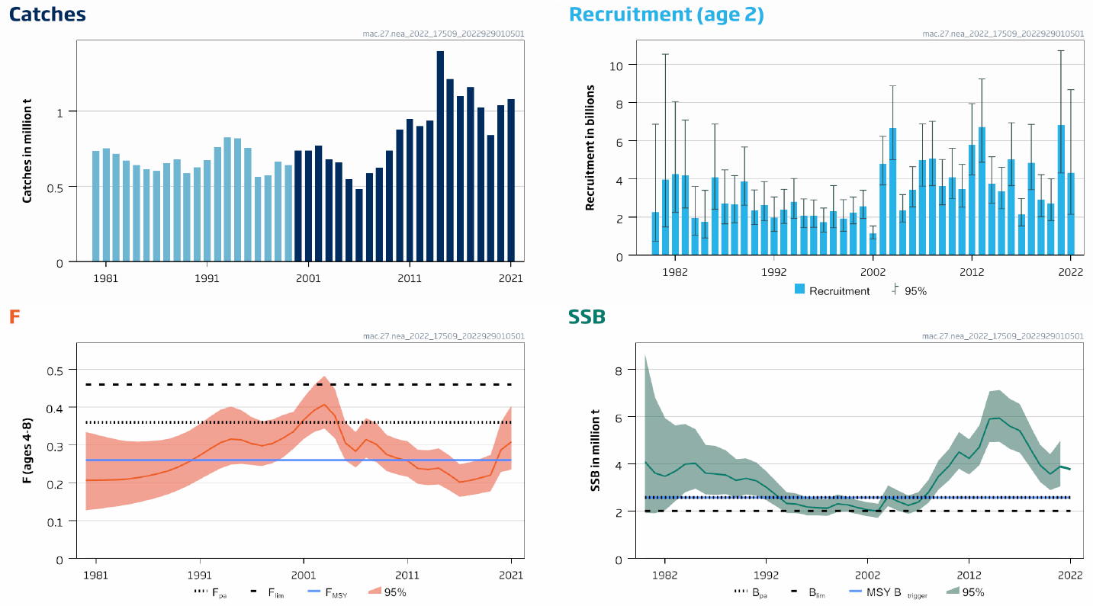
Mackerel: high recruitment, stock coming down

Slide 12
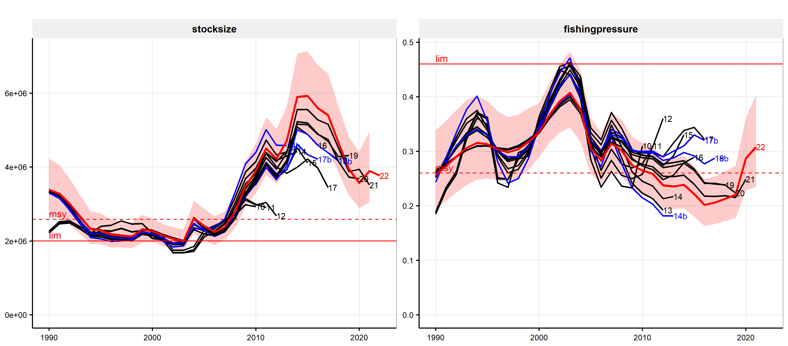
Mackerel: very uncertain assessment

Slide 13
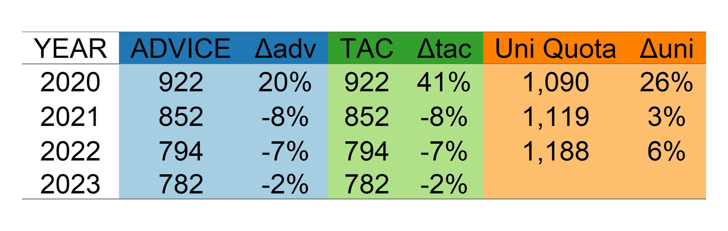
Mackerel: recommended (slightly) lower catch

Slide 14
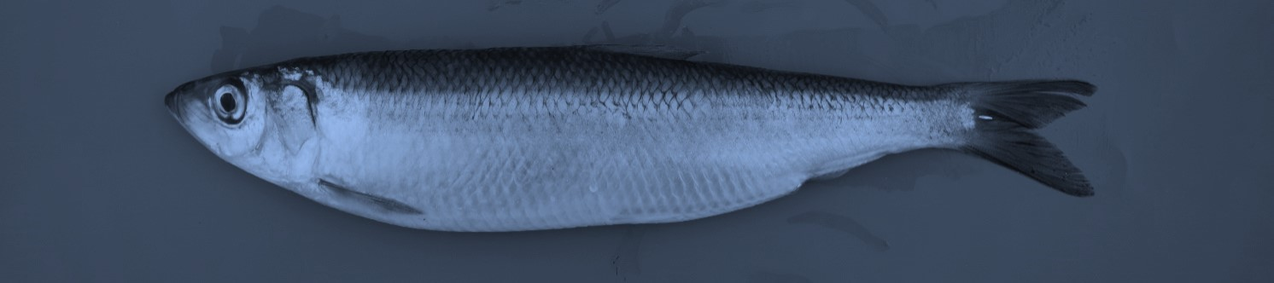
Atlantic herring (HER)

Slide 15
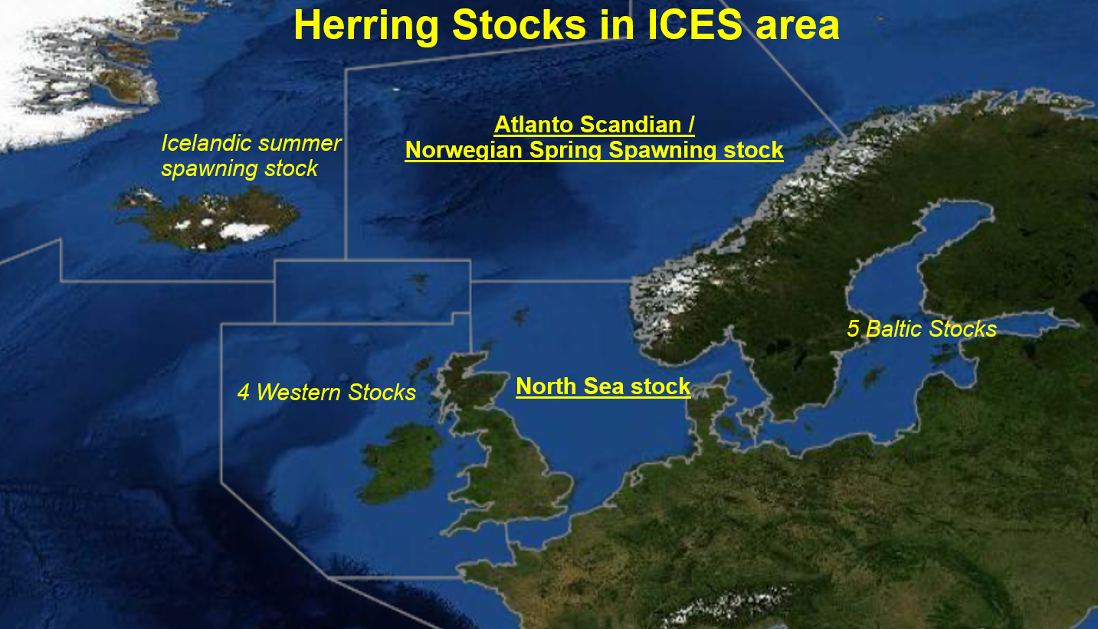

Slide 16
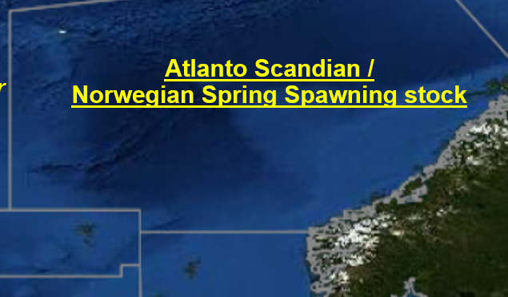
Key aspects of Atlanto-scandian (AS) herring
Catch area seems to be contracting
No agreement on sharing; some overshoot over advice
Stock declining, despite strong year class
Relatively consistent assessment
Advice 2023 15% lower than for 2022

Slide 17
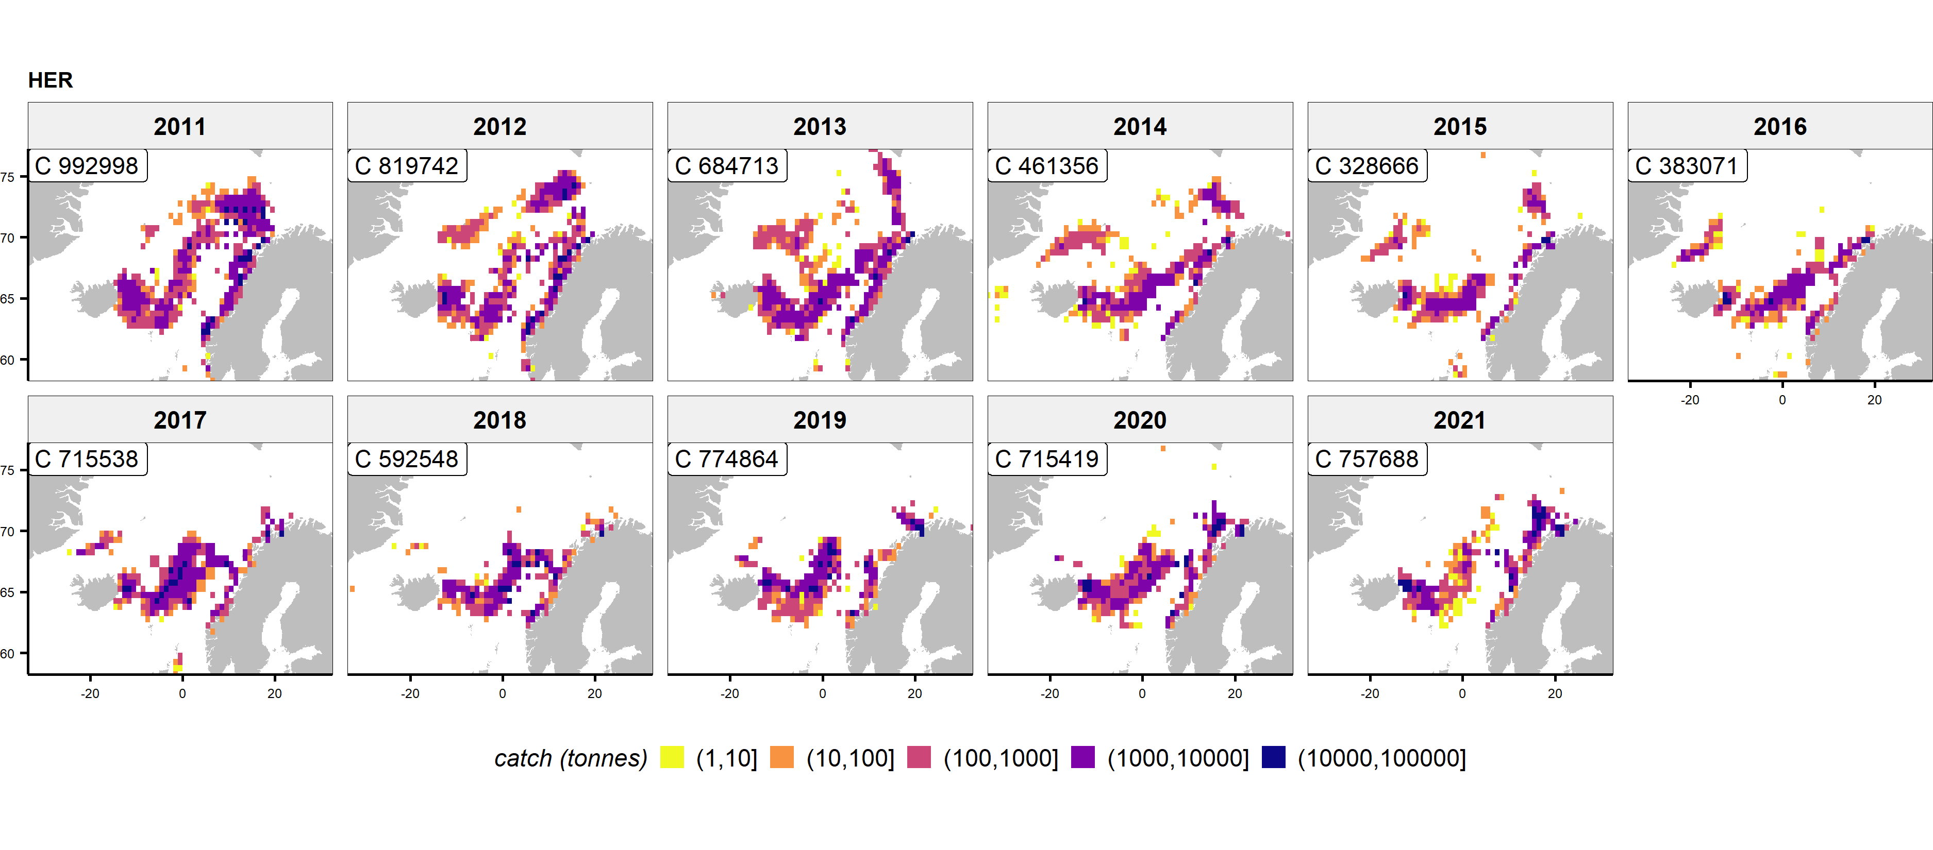
AS herring: contracting catching area

Slide 18
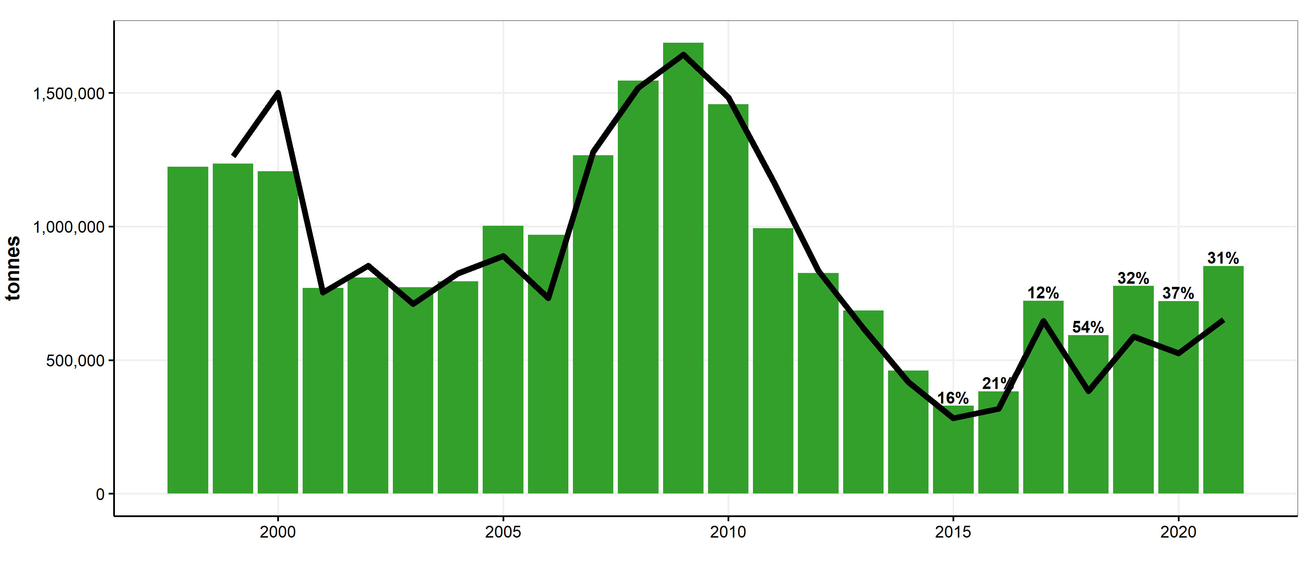
AS herring: some overshoot of catches over advice

Slide 19
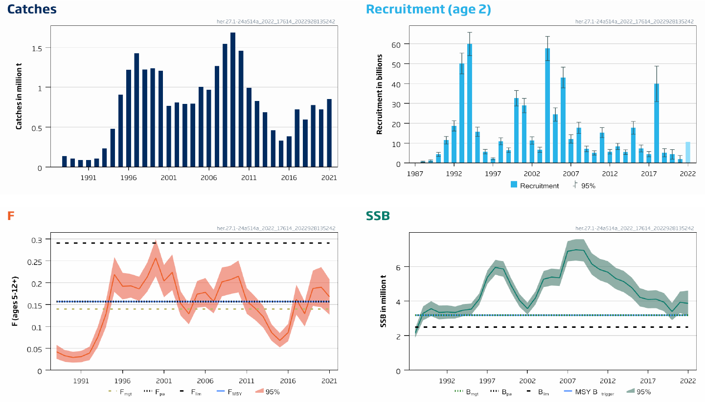
AS herring: stock declining

Slide 20
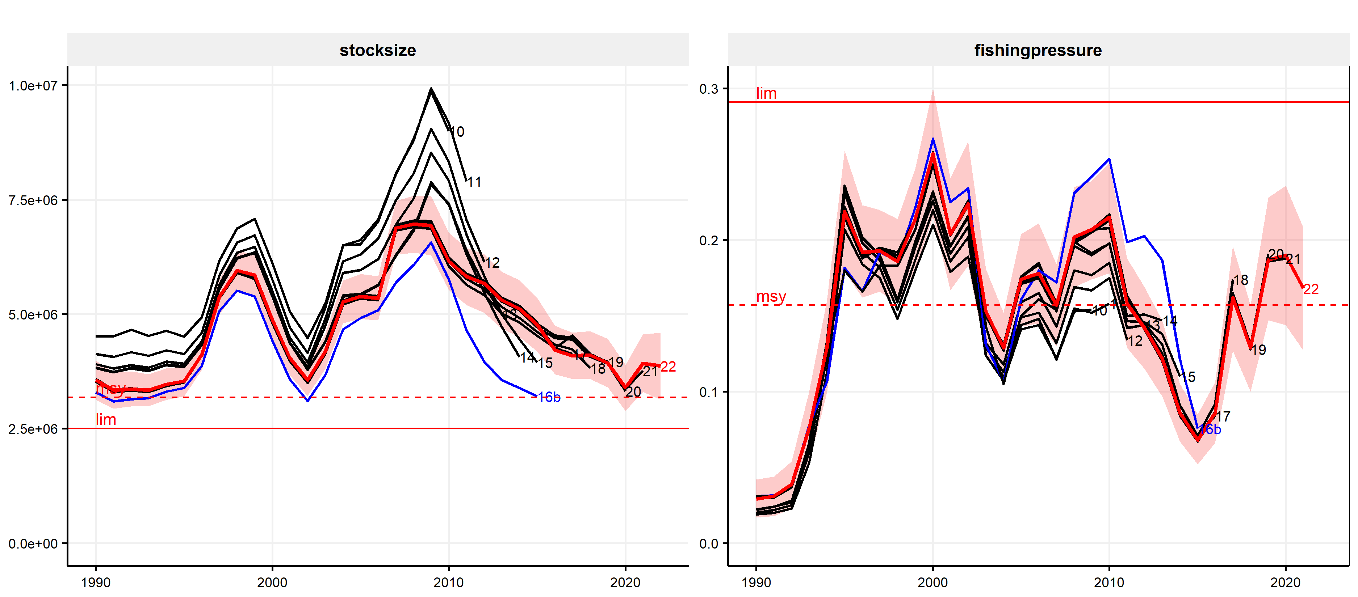
AS herring: relatively consistent assessment

Slide 21
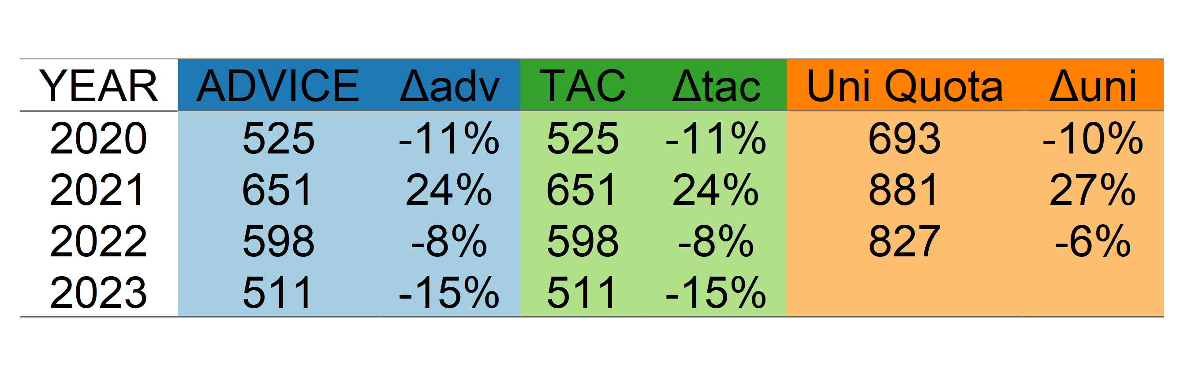
AS herring: 15% lower advice

Slide 22
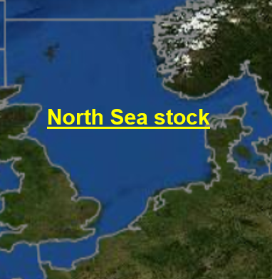
Key aspects of North Sea herring
Some mismatch between TAC and stock area
Stock coming down (close to trigger biomass)
Uncertainty in stock level in assessment (scaling)
Stable spatial patterns in catches
Advice for 23% reduction (relative to high advice 2022)

